Slide 1
INSURANCE FRAUD DETECTION USING ML
ARUL ARASU N (Roll No: 20Z306)
DHANASEELAN V (Roll No: 20Z313)
DINESH BAABU R (Roll No: 20Z315)
LOKAJIT G (Roll No: 20Z328)
SUDARSHAN S (Roll No: 20Z350)

Slide 2
INTRODUCTION
In the era of digital world most of the people play some handsome tricks that plays the role the society, organization and the other some sustainable services that could illegally may generate fraud data on foster research of health care services, insurance policy services, bank services and some sustain factors of services that may hazardously incur the fraudulent activities that make economic growth anonymously. These factors affecting the other intellect services of a patient’s information may implant the technology of Machine Learning.
This project work collects insurance claim records and performs necessary data processing techniques to make it fitting to the machine learning models. Different machine learning models are trained with the data and evaluated with various performing metrics to ensure to come up with the right model. The features contribution towards the learning is identified through model interpretability. The details of the project work would be discussed in the forthcoming chapters.

Slide 3
FEATURE SELECTION
MUTUAL INFORMATION
CHI-SQUARED
SPEARMAN’S CORRELATION COEFFICIENT

Slide 4
ENCODING
2 types
One-Hot Encoding
Response Encoding
Categorical variables converted from the database : State, Country

Slide 5
MODELLING

Slide 6
DATA SAMPLING
Balanced Class Weights
Balanced class weights are typically used in classification tasks, where the class distribution is imbalanced. Without balanced class weights, the model might be biased towards the majority class, leading to poor performance on the minority class. It assigns different weights to the classes, giving more importance to the minority class. This encourages the model to pay equal attention to both classes during training.
Under-Sampling
Under-sampling is necessary when you have a large amount of data for the majority class, but you want to balance the class distribution to prevent the model from being overwhelmed by the majority class. It involves randomly removing a subset of instances from the majority class to match the number of instances in the minority class.
Over-Sampling
Over-sampling is used when you have a limited amount of data for the minority class, and you want to balance the class distribution. It helps the model better learn the patterns in the minority class. It involves creating synthetic samples for the minority class using techniques like SMOTE (Synthetic Minority Over-sampling Technique). This increases the number of instances in the minority class.

Slide 7
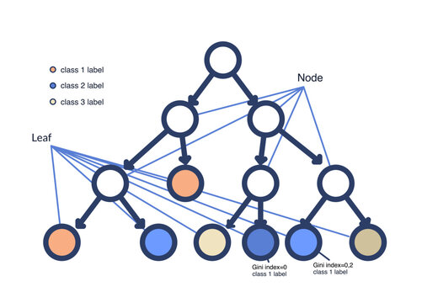
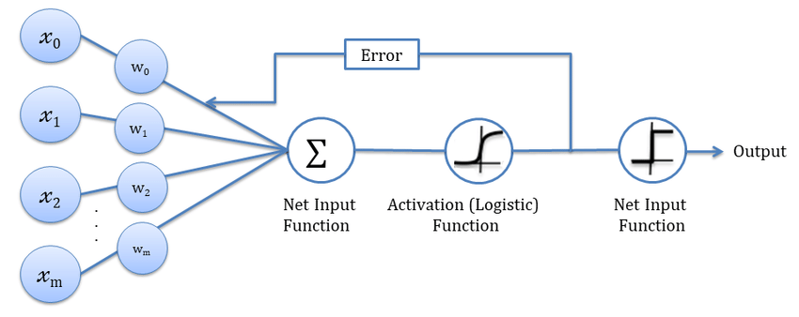
Decision Tree
Logistic Regression
TRAINING MODEL

Slide 8

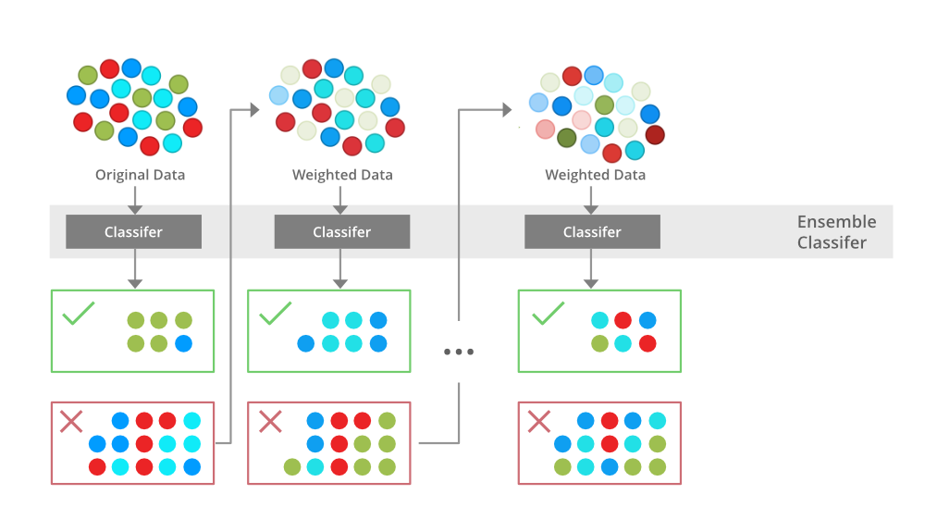
Random Forest
XGBOOST
TRAINING MODEL

Slide 9
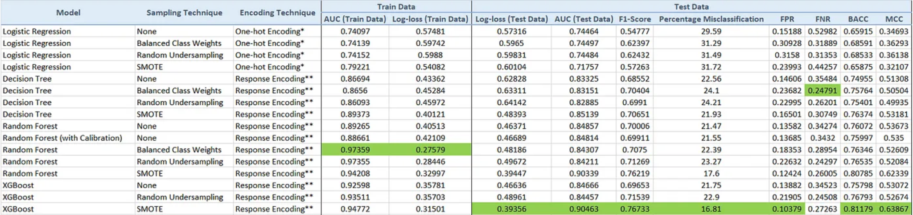
Model Conclusion

Slide 10
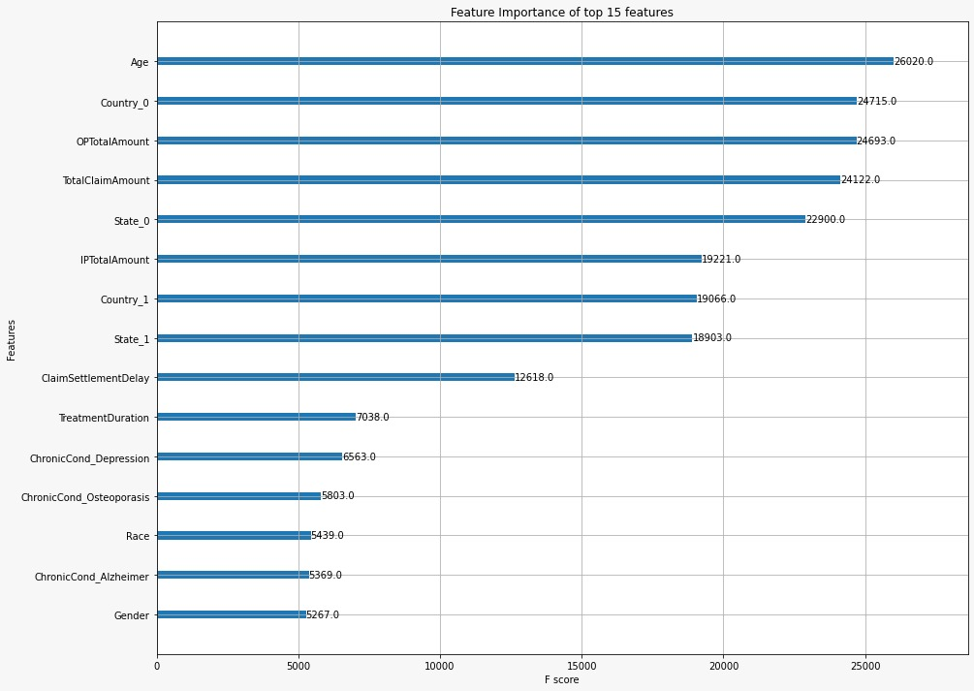

Slide 11
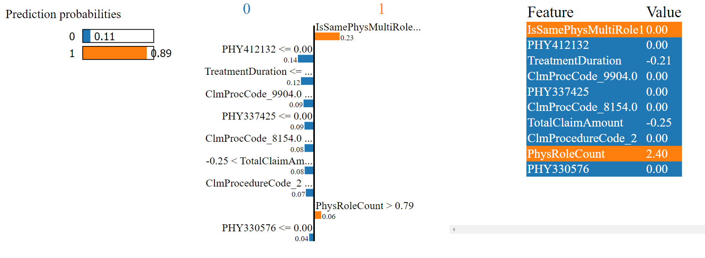
Model Interpretability - LIME
Positive

Slide 12
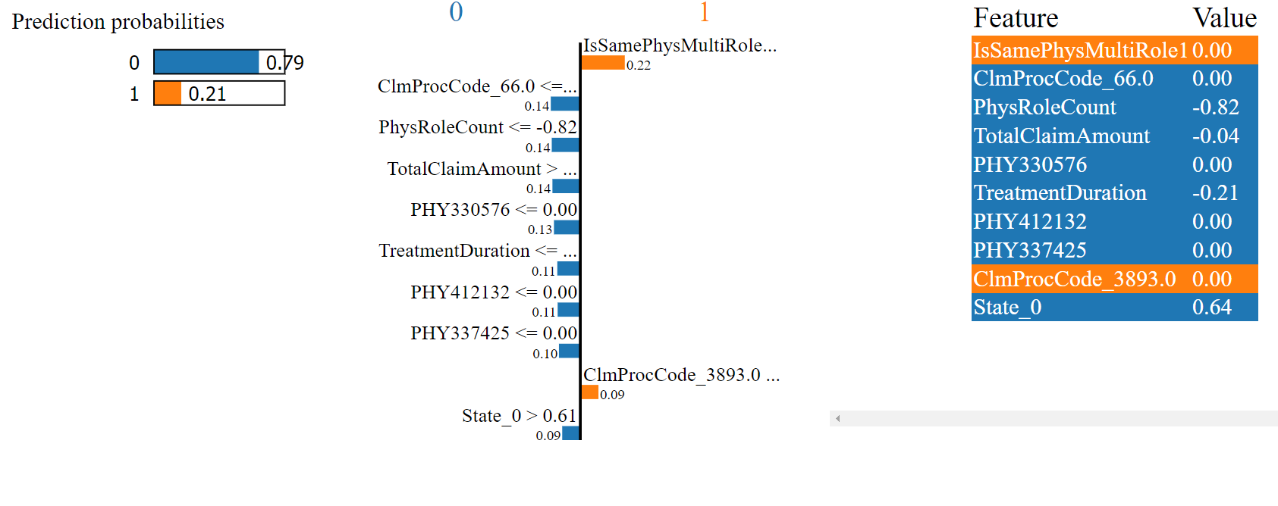
Model Interpretability
Negative

Slide 13
THANK YOU !!!!

